Slide 1
Viscoelastic internal damping finite-difference model for musical instruments physical model sound production
Rolf Bader
Institute of Systematic Musicology
University of Hamburg

Slide 2
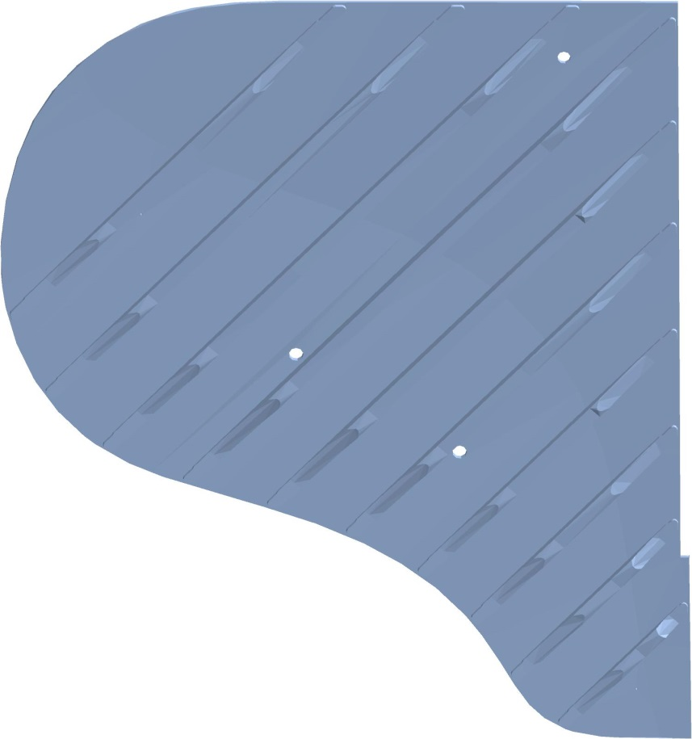

Importance of internal damping
Physical Model of Steinway M piano
Single string, with normal damping
Normal soundboard damping with one parameter for all frequencies
2) Extreme soundboard damping
3) No soundboard damping

Slide 3
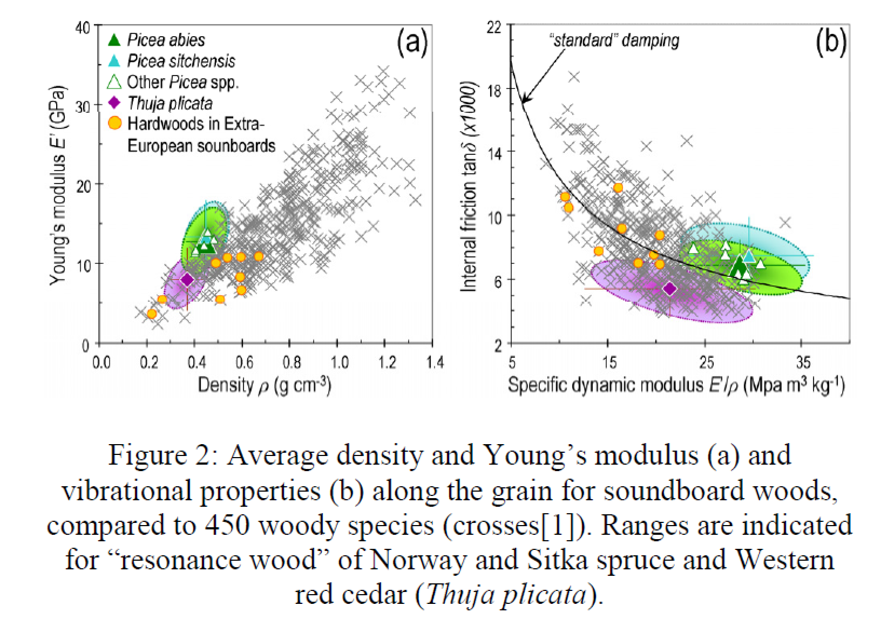
Soundboard wood damping
From: I. Bremaud: What do we know on “ resonance wood ”” properties?
Selective review and ongoing research. Proceedings of the Acoustics 2012 Nantes Conference.

Slide 4
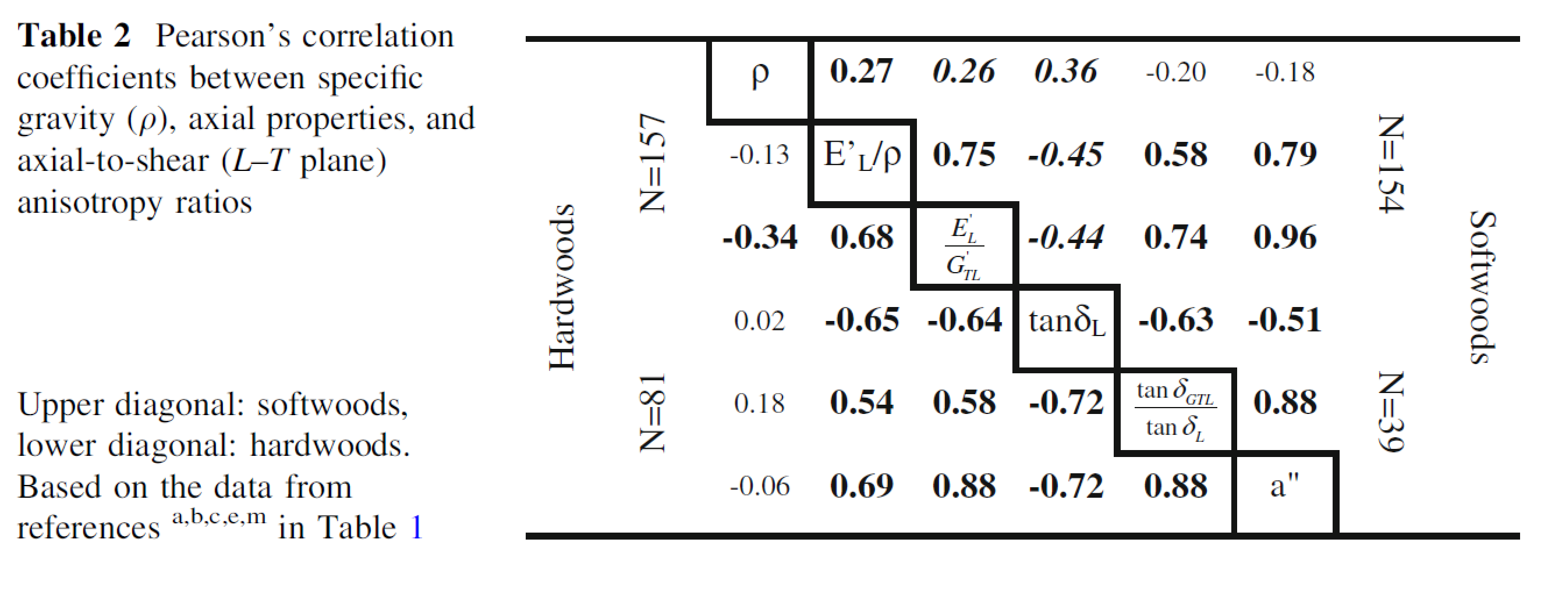
Wood damping correlation with Young‘s modulus, not with density
From: Iris Brémaud, Joseph Gril & Bernard Thibaut: Anisotropy of wood vibrational properties: dependence on grain angle and review of literature data. Wood Sci Technol (2011) 45:735–754. DOI 10.1007/s00226-010-0393-8

Slide 5
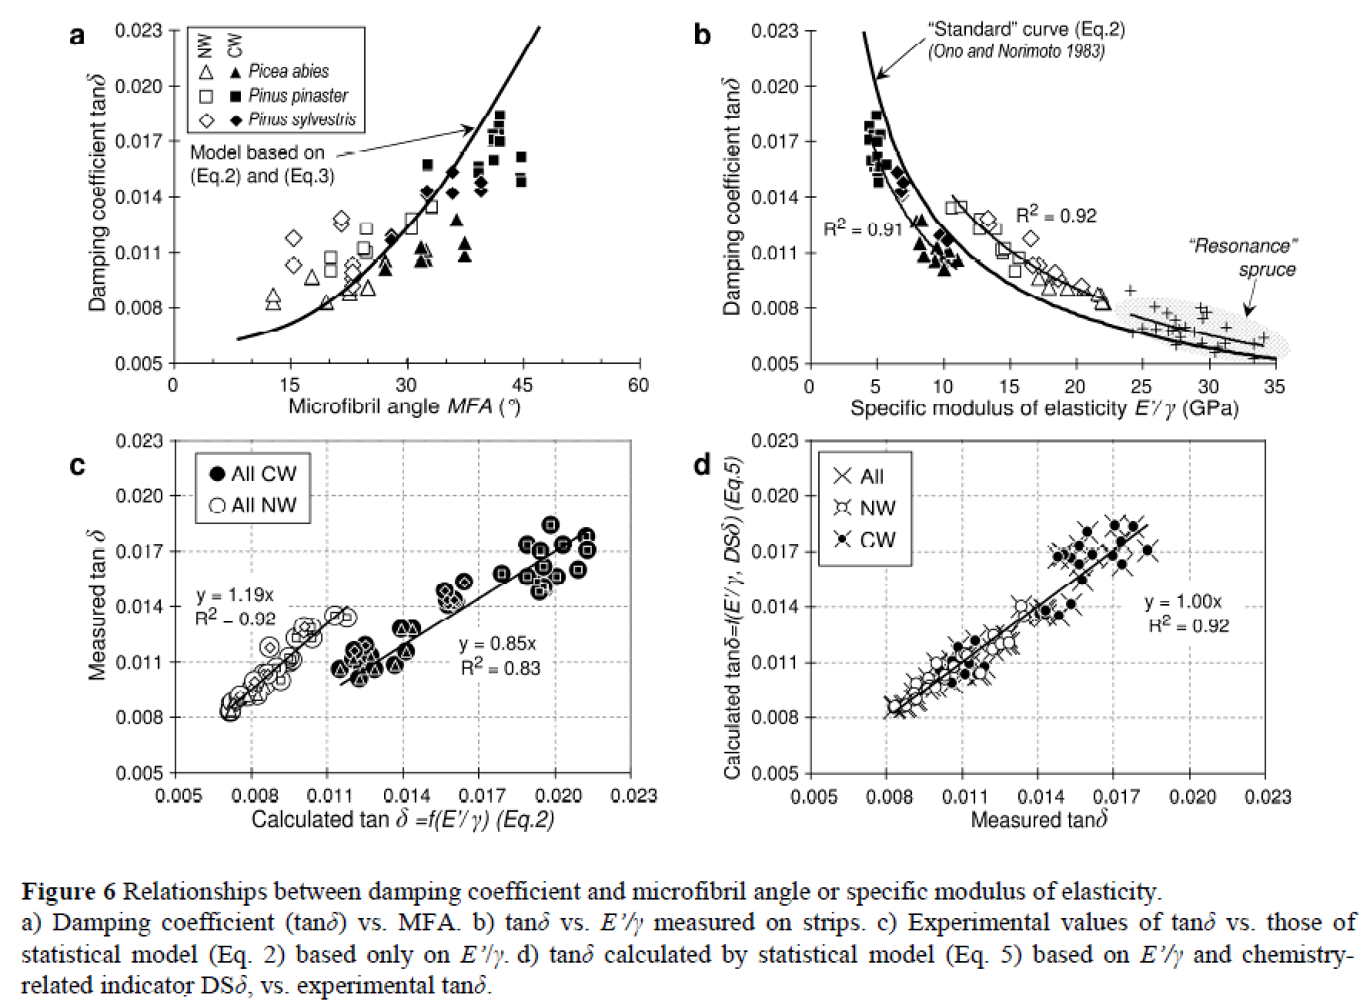
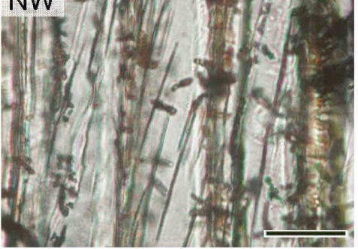
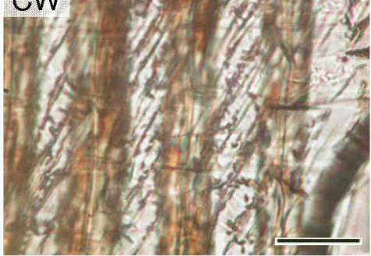
Microfiber grain angle dependency
Normal wood
Compression wood
From: Iris Bremaud, Julien Ruelle, Anne Thibaut, Bernard Thibaut: Changes in viscoelastic vibrational properties between compression and normal wood : roles of microbril angle and of lignin. Holzforschung 67(1), 75-85, 2013.

Slide 6
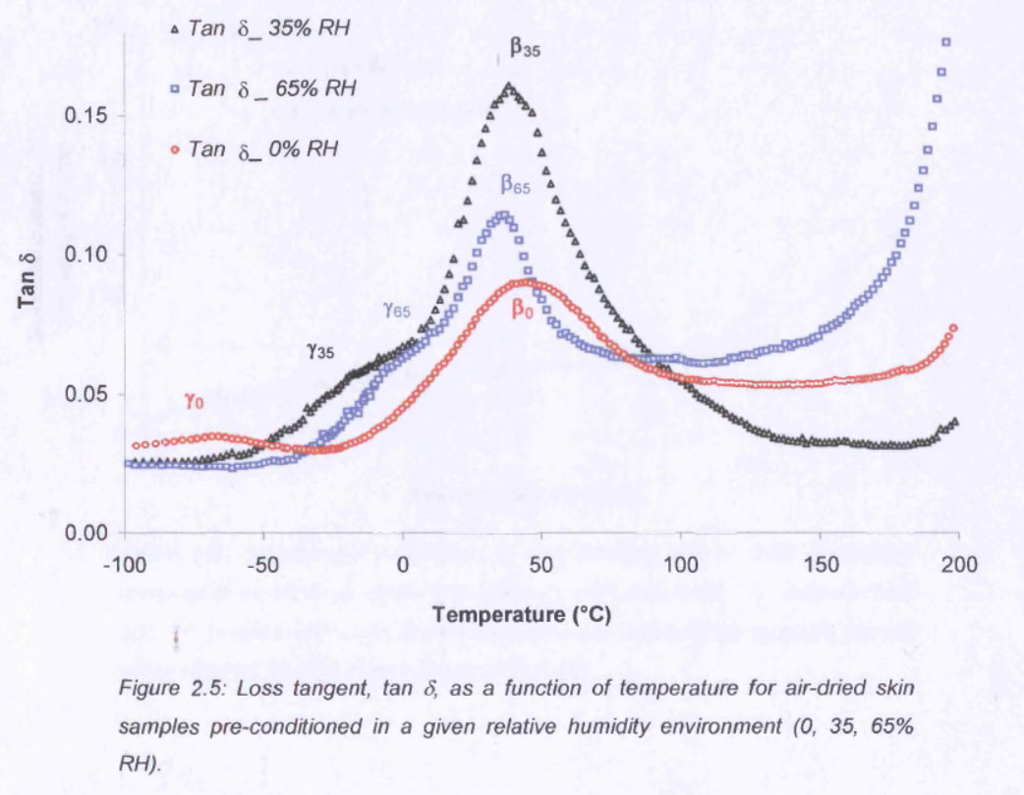
Leather glass transition damping
From: Sujeevini Jeyapalina. Studies on the hydro-thermal and viscoelastic properties of leather. PhD, Leichester 2004.

Slide 7
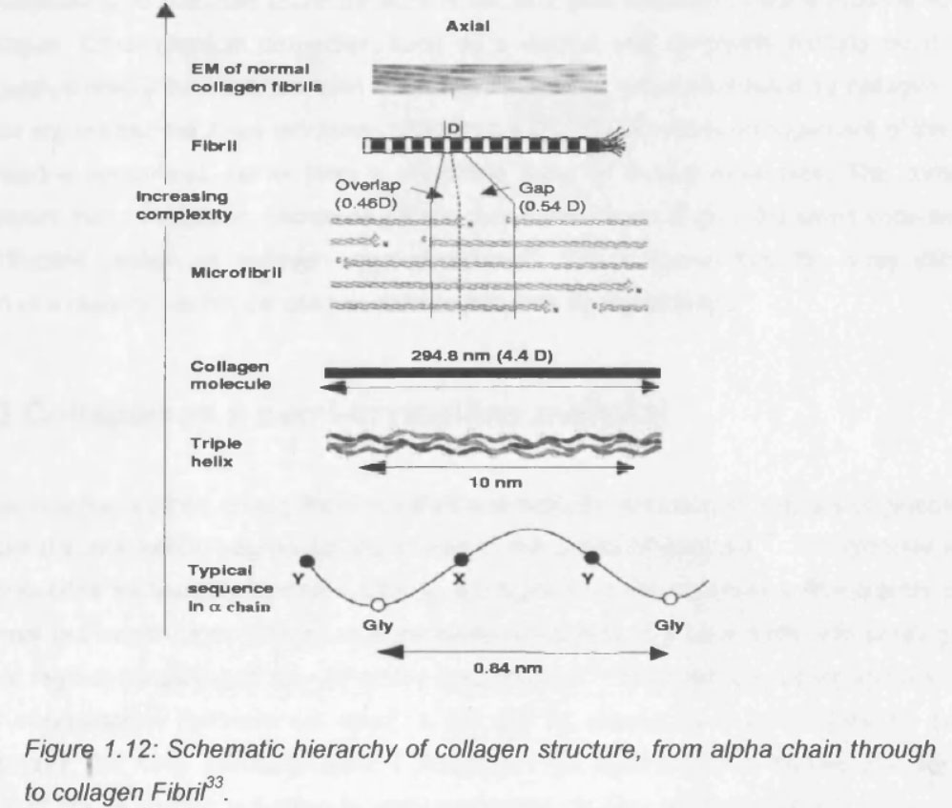
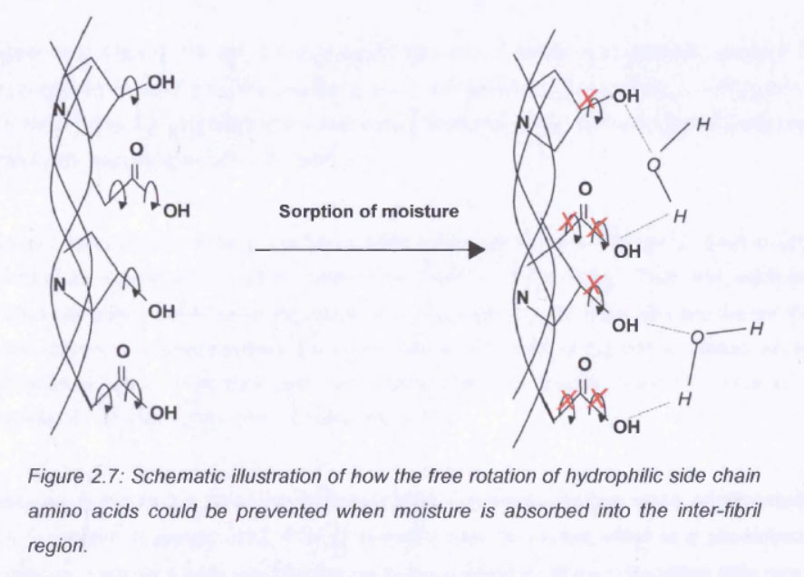

Slide 8
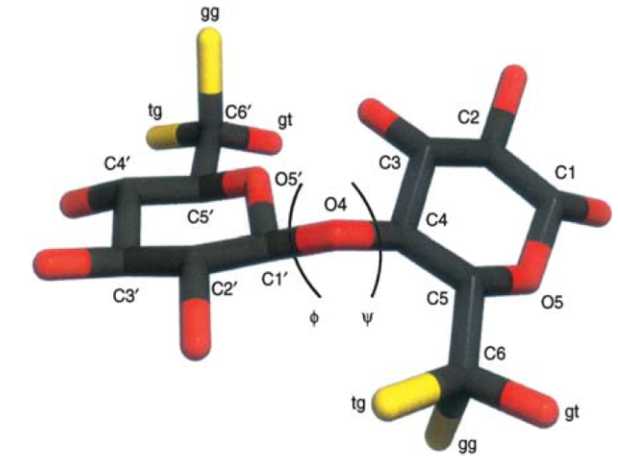
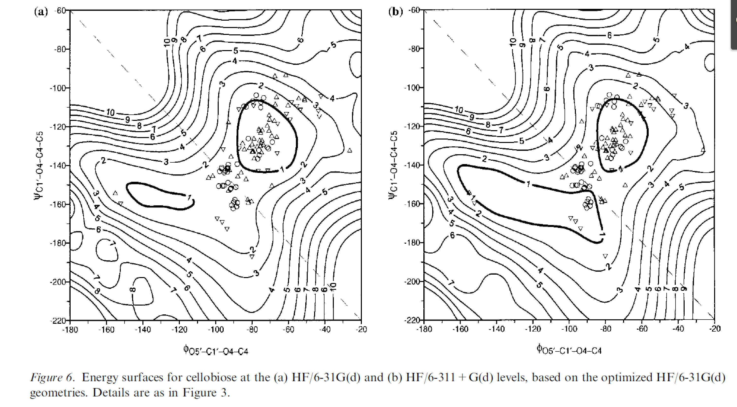
Models of internal damping
Thermal losses (Zener, Harris)
Molecular conformational changes (Glassstone, Laidler, Eyring)
From: Alfred D. French and Glenn P. Johnson: Advanced conformational energy surfaces for cellobiose. Cellulose 11: 449–462, 2004.

Slide 9
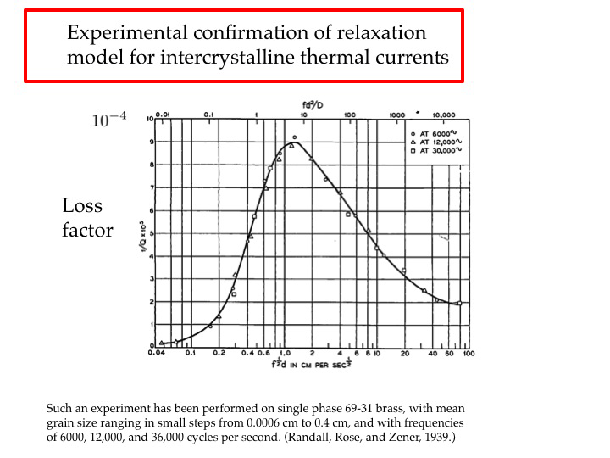
Thermal losses produce band gaps
From: A.D. Pierce: Intrinsic damping, relaxation processes, and internal friction in vibrating systems. POMA 9, 2010

Slide 10
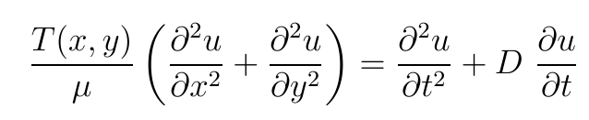
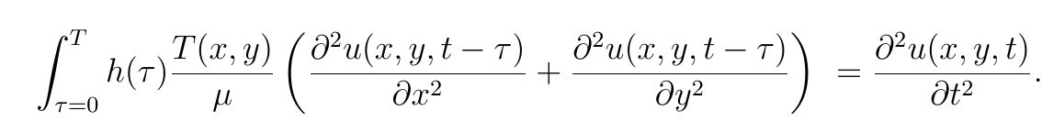
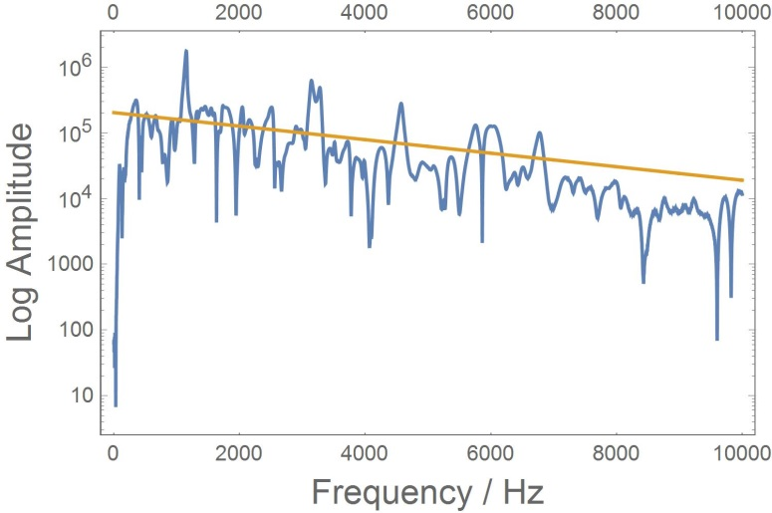
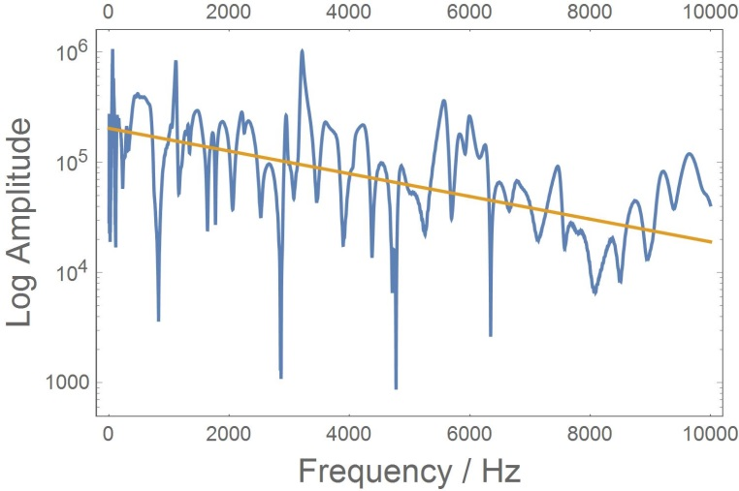
Kinds of damping
One damping parameter
Frequency-dependent damping spectrum
Spectra when knocking on wooden plate 30x30cm (left) before and (right) after laquering

Slide 11
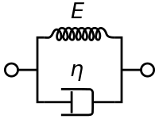

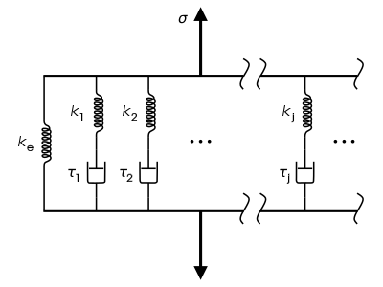
Modelling the frequency band gap of damping:
Maxwell / Kelvin-Voigt model
Maxwell model
Kelvin-Voigt model
Complex Young‘s modul (FEM, FDM)
Maxwell Kelvin-Voigt

Slide 12
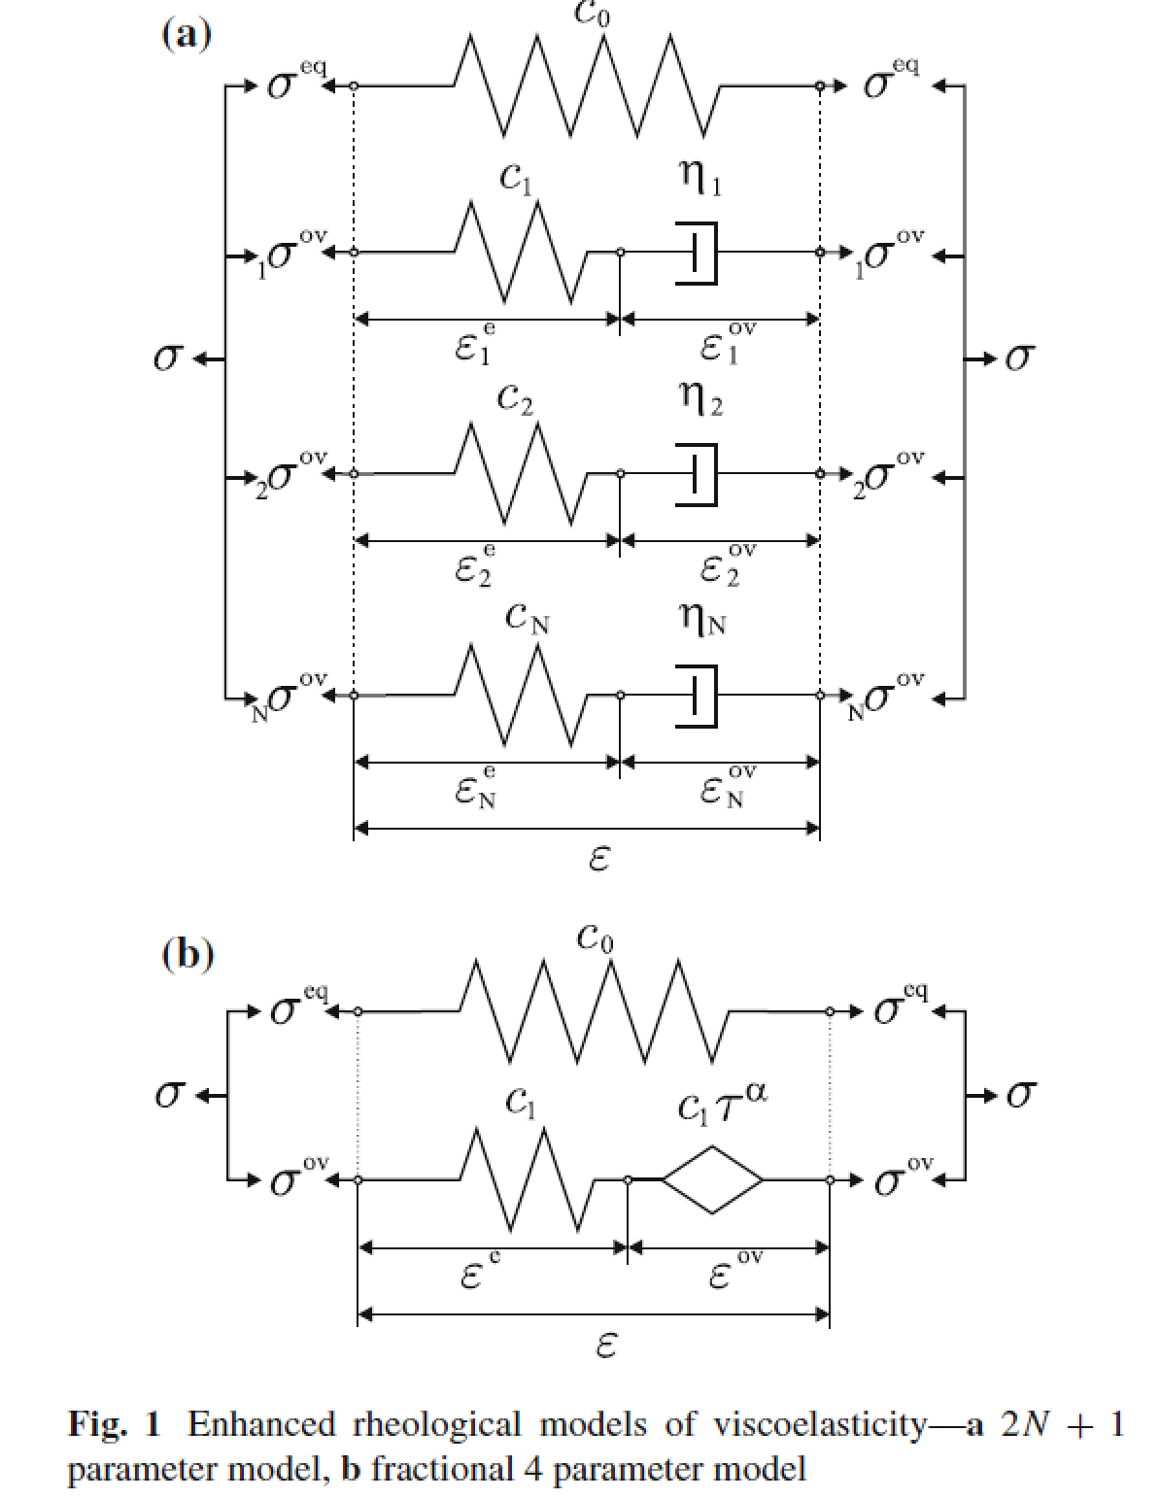
Fractional model, FEM calculation
From: Sebastian Müller, Markus Kästner , Jörg Brummund & Volker Ulbricht: On the numerical handling of fractional viscoelastic material models in a FE analysis. Comput Mech (2013) 51:999–1012. DOI 10.1007/s00466-012-0783-x

Slide 13

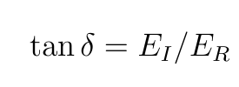
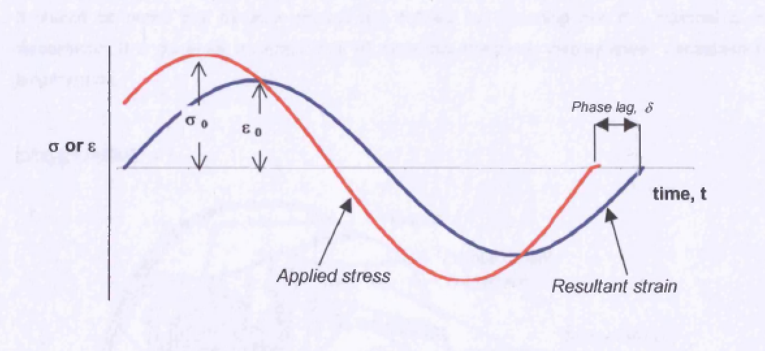
Complex Young‘s modulus
Complex stress-strain model:
σ : stress
ε: strain
Phase-shift between stress and strain:
E_{I}, E_{R}: imaginary and real parts of E

Slide 14


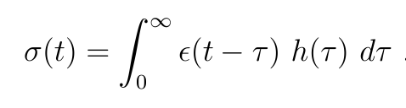
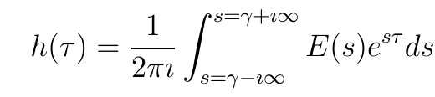
Model
Complex stress-strain model:
σ : stress
ε: strain
α: damping
ω: frequency
s: complex frequency
u: displacement
A: Amplitude
μ: damping constant
Transfer (1) into time domain
(multiplication in frequency domain -> convolution in time domain)
Inverse Laplace transform:
γ: integration constant needed for convergence, influences damping strength Ds

Slide 15
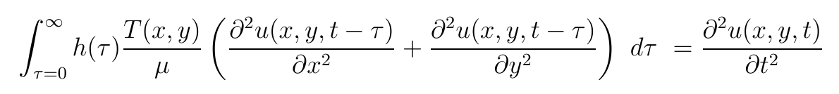
Model
Membrane
Differential Equation
u: displacement
T(x,y): tension
μ: area density
D: damping coefficient
Viscoelastic membrane differential equation:

Slide 16
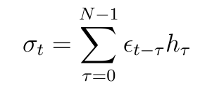
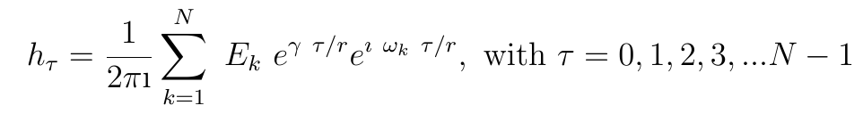

Discrete model
σ_{t} : stress at discrete time point t
ε_{t} : strain at discrete time point t
N: number of time points
r: sample rate
h_{τ} : damping function at time point τ
Discrete frequency:
h_{τ} need to be real, therefore:

Slide 17
Model parameters
Input parameter:
Inverse Laplace integration (damping) exponent γ
Damping amplitude A = Re(Ek)
Length of h (number of periods)
Output parameters:
Damping exponent μ
Filter constant Q
Contraints:
Avoid (or control) overflow
Reduce computation cost

Slide 18
Computation time
GPU | N | Sound length | Computation time
GTX 940 | 1 | 1 sec | ~ 20 sec
GTX 940 | 1000 | 1 sec | ~ 380 sec
GTX 1070 | 1 | 1 sec | ~ 12 sec
GTX 1070 | 1000 | 1 sec | ~ 60 sec

Slide 19
Result Target f = 4174 Hz
Length of h:
10 periods of f
25 periods of f
35 periods of f
50 periods of f
Each case γ = n x [10: 1/(n 10) ; 25: 1/(25 n) ; 35: 1/(25 n); 50: 1/(50 n)] with n = 1, 2, 3, … 10
Each case Re{Ek} = n x 0.0003 with n = 0, 2, 3, … 10

Slide 20
Damping of f = 4174 Hz
Example:
50 periods
Re{E(s)} = 1 / 0.0003
Partial decay μ from simulation

Slide 23
Mass point, Spetra
Non-exponential decay leads to sidebands with high γ.

Slide 26
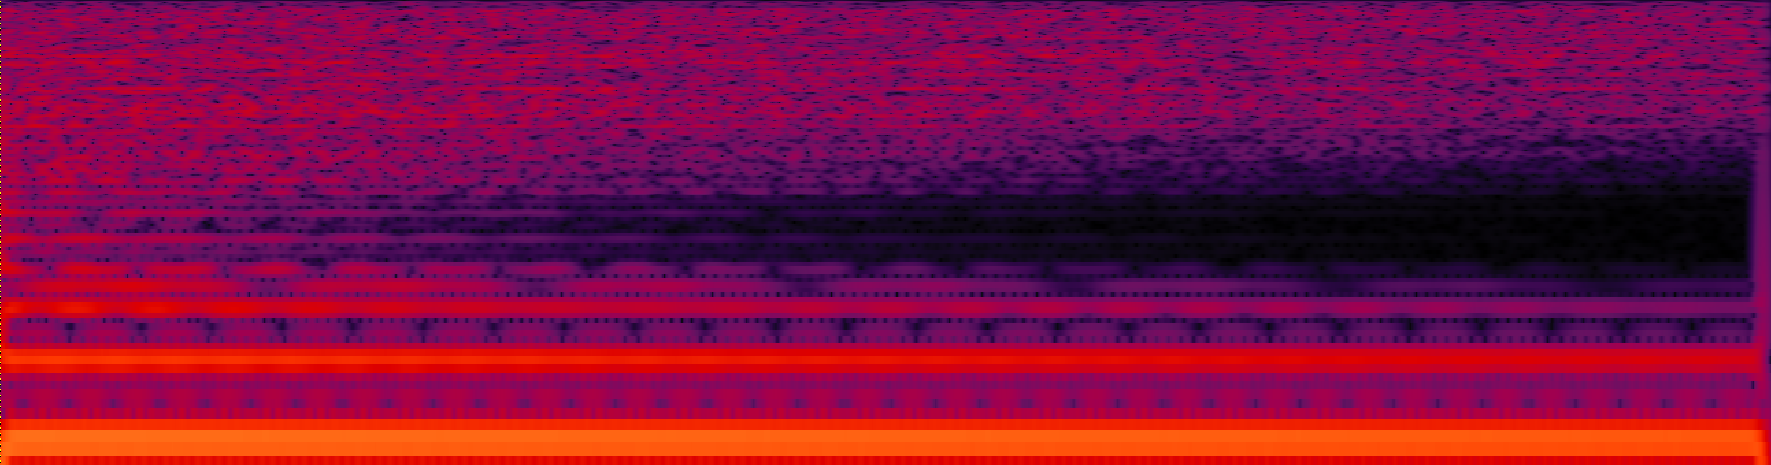
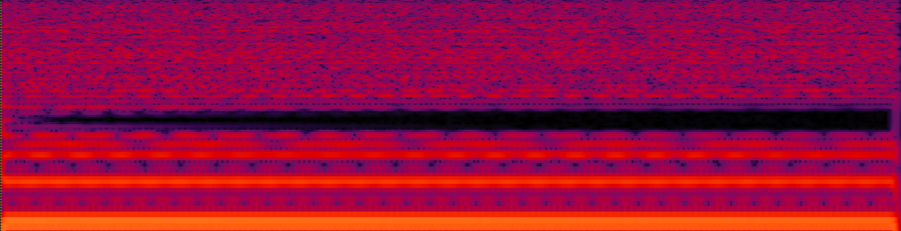
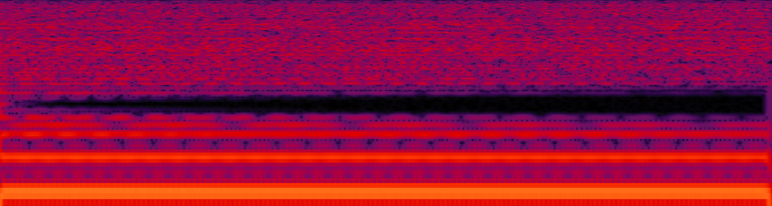
20 kHz
10 periods,
Re{E(s)} = 0.0003
γ = .1
20 Hz
0 ms
Time
400 ms
20 kHz
10 periods,
Re{E(s)} = 0.0003
γ = .01
20 Hz
0 ms
Time
400 ms
20 kHz
50 periods,
Re{E(s)} = 0.0003
γ = .01
20 Hz

Slide 27
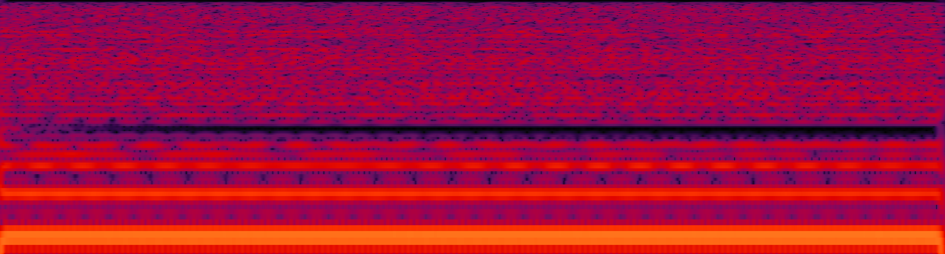
20 kHz
50 periods,
Re{E(s)} = 0.0003
γ = .01
20 Hz
0 ms
Time
400 ms
20 kHz
50 periods,
Re{E(s)} = 0.0003
γ = .002
20 Hz
0 ms
Time
400 ms

Slide 28
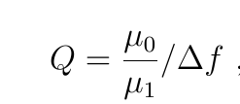
10 periods

Slide 29
25 periods

Slide 30
35 periods

Slide 31
50 periods

Slide 34
Energy supply by overshooting

Slide 35
Examples
Drum with long fundamental:
with viscosity
no viscosity
Piano soundboard (Steinway M-Model) knocking:
no viscosity
with viscosity 125 Hz damped 250 Hz damped 1000 Hz damped
Piano soundboard one string played:
no viscosity
with viscosity

Slide 36
Summery
Viscoelasticity does not lead to an exponential decay of single frequencies.
Three parameters tunable:
Inverse Laplace transform real value: γ
Complex Young‘s modulus: Re{E(s)}
Length of h (amount of periods)
Maximum μ independent of length of h
Maximum μ dependens on target frequency
Q is getting sharper with smaller γ

Slide 37
Future work
Fit model to experimental data
Implement flexible filter frequencies using multiple h_{τ}
Add controlled energy supply to model interaction of multiple musical instrument parts by time-dependent h

Slide 38
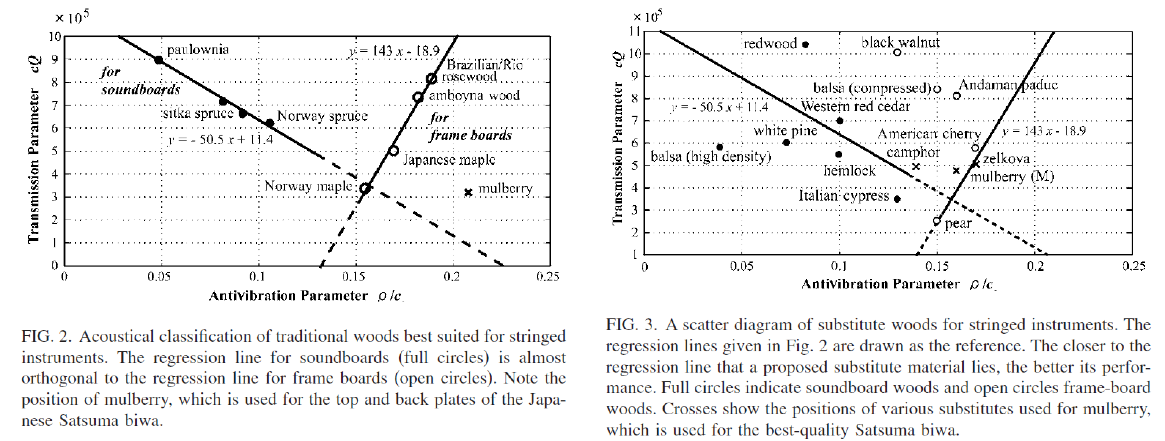
String instrument damping dependency on antivibration parameter ρ/c
From: Shigeru Yoshikawa: Acoustical classification of woods for string instruments. JASA 122 (1), 568-573, 2012.

Slide 39
Vacuum experiment
Thünen Institute, Hamburg
30x30cm plate, sine sweep
Radiation
(microphone)
Energy on plate
(piezo)
Fig. 8: Amplitudes relative to 760 Torr of the piezo measurements on the wooden plate in dB. Contrary to the clear picture with the microphone measurements, the vibrational energy on the plate is much less consistent and does not follow simple rules. In the high frequency range from about 2 kHz the tendency is quite clear, the negative dB values point to an increase of energy on the plate with decreasing vacuum consistent with the expectation. Still in the low and middle range the behavior is much more complex and not yet understood.

Slide 40

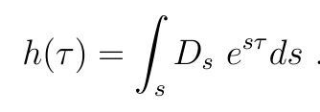
Model
Example for only a single frequency damped:
δ: Dirac delta
E0: Absolute Young‘s modulus
All non-viscoelastic frequencies add to a Dirac delta at the τ=0.
Only the damping frequency leads to a time series in τ.
Frequency-dependent damping leads to integral over spectrum

Slide 41
f = 306 Hz

